Slide 1


托福听力2
金牌听力名师
大菁儿老师
2021.6.1

Slide 2
第一节课回顾： 介绍改革后的托福听力特征； 听力考试规则； 托福听力的常见问题； 从听力角度背单词； 托福听力总原则； 长对话的分类； 长对话部分的题型——主旨题解题技巧 长对话部分的题型——细节题解题技巧

Slide 3
长对话部分的题型——重听题解题技巧
长对话部分的题型——功能题解题技巧
长对话部分的题型——推测题解题技巧
长对话部分的题型——推理题技巧
听力笔记方法、原则及笔记符号

Slide 4
学生求助，提出问题，教授回答帮助分析问题，解决问题
公式：(1+2+1)+1
红色：开头+结尾 2：波折 括号外：重听题（言外之意）
四个故事情节点和一个语言考察点

Slide 5
长对话题型及解题技巧
3. 态度重听题：注意材料中的语调变化
突然出现声音变大、语调降低或者说话重复、结巴等现象
Why does the professor say this：
—— attitude toward sth.
练习TPO28-C1重听题

Slide 6
TPO28-C1重听题 1'27-1'40
5 Why does the professor say this：
When you were finished writing, did you go back and ask yourself if all of the material was relevant?
A. To find out how many drafts does the student wrote.
B. To encourage the student to review his own work.
C. To emphasize the need for the student to follow the guidelines.
D. To propose a different solution to the problem.

Slide 7
Professor:
Yes. Revised. Let me ask. Uh. When you were finished writing, did you go back and ask yourself if all of the material was relevant?
Student: Well, no.
Professor: I do think there are areas that can be cut. I guess what I am saying is that your paragraphs aren’t really presented in a logical order. The direction of your argument isn’t crystal clear. And there’s some unnecessary material getting in the way.

Slide 8
练习TPO17-C1师生讨论——为论文寻找视频资源
5.Why does the professor say this: well, think about it,….most important…., right
A. To point out that the topic of the student's paper has been covered before.
B. To convince the student to write about the production.
C. To persuade the student to change the topic of his paper.
D. To see if the student agrees with her opinion about the production.

Slide 9
前面Student：So now what do I do? If there is no video.
Professor：Well, think about it. This is the most important 20th century staging of A Midsummer Night’s Dream, right?

Slide 10
4. 功能题：有些直接回答，也有部分在材料中不直接回答
TPO41-C2 生活服务——减免学费：
功能题：
3. Why does the woman mention civic clubs, foundations, and large corporations?
A. To suggest organizations the man should visit to learn about scholarships
B. To give some examples of organizations that offer scholarships
C. To explain why some scholarships are very competitive
D. To point out that it is appropriate to use scholarship money from multiple sources

Slide 11
MALE STUDENT: Why isn't all the information listed in the catalog? It'd be so much easier
FEMALE OFFICIAL: Oh, if we did that, the catalog would be too heavy to pick up! Civic clubs, foundations—organizations from all over the country offer scholarships or other financial assistance to college students. And all kinds of companies have programs to help their employees' children go to college. If either of your parents works for a large corporation, have them check to see if their

Slide 12
TPO28-C1
功能题：
Why does the professor mention the political science club?
A. To encourage the student to run for club president
B. To point out that John Dewey is a member of a similar club
C. To suggest an activity that might interest the student
D. To indicate where the student can get help with his paper

Slide 13
MALE STUDENT: Definitely. The topic's John Dewey!
FEMALE PROFESSOR: Yes. Are you interested in leading part of the discussion? Tom Hayward is looking for someone to help out. I think you'll have a lot to contribute.
MALE STUDENT: That'd be fun! I'll give him a call.

Slide 14
TPO20-C2：师生讨论—申请研究经费的问题：
功能题：
5.Why does the professor say this:It is a mouthful I suppose.
A. He thinks the fund is rather limited.
B. He agrees that the fund’s name is rather long.
C. He thinks the student needs help with her project.
D. He is surprised that the student is not familiar with the fund.

Slide 15
5 推测题：和学生的下一步打算有关
What will the man do after the conversation?
What will the student include in his assignment?
What kind of assignment will the professor give?

Slide 16
TPO40-C1 设计服务项目
推测题：2'27-2'38
5.What does the professor say the student should do for his project?
A. Compare an on-campus service model with an off-campus one
B. Interview the service manager and employees at the cafeteria
C. Recommend service improvements at the cafeteria and the bookstore
D. Analyze the service design of a nearby restaurant

Slide 17
FEMALE PROFESSOR: Well, campus businesses like the cafeteria or bookstore don't quite follow the kinds of service models we're studying in class. You should go to some other, local establishment, I'd say.
MALE STUDENT: I see.
FEMALE PROFESSOR: But just call the manager ahead of time so they aren't surprised.

Slide 18
TPO37-C1 古代秘鲁羽毛工艺品
anthropology 人类学
Peru 秘鲁
ceremonial object
推测题:
5.At the end of the conversation, what does the professor suggest the student do next?
A. Do some initial background reading on feather work.
B. Contact one of her colleagues in Peru.
C. Attend an exhibition at a museum.
D. Choose a new research topic.

Slide 19
FEMALE PROFESSOR: Well, campus businesses like the cafeteria or bookstore don't quite follow the kinds of service models we're studying in class. You should go to some other, local establishment, I'd say.
MALE STUDENT: I see.
FEMALE PROFESSOR: But just call the manager ahead of time so they aren't surprised.

Slide 20
6.推理题：是让考生根据所听内容进行推理从而选出答案的题型。
常见的提问方式包括：
What does the woman imply about the new medical research?
What can we infer from the professor’s comment on the New England system?

Slide 21
TPO40-C1 设计服务项目
推理题
4.What do the speakers imply about the bakery the student went to recently? [Click on 2 answers.]
A. The apple pie he bought there was not as good as it usually is.
B. The bakery's service design was inefficient.
C. The bakery needs additional employees to fix a service gap.
D. The bakery did not meet a service standard.

Slide 22
MALE STUDENT: There was a little label that said “apple pie,” where it's supposed to be, but there wasn’t any left.
FEMALE PROFESSOR: And that's what's called a service gap. Maybe there wasn't enough training for the employees, or maybe they just ran out of pie that day. But something's wrong with the process, and the service standard wasn’t being met.

Slide 23
TPO46-C1 apply for housing
推理题
3.What does the woman imply when she mentions the jazz festival?
A. It was free for residents of the music house.
B. It was held at the music house.
C. Music house residents were encouraged to perform at it.
D. Music house residents were involved in organizing it.

Slide 24
FEMALE EMPLOYEE: Well, for example, every month I think it is, there’s an informal concert… any house resident can perform. And remember the big jazz festival at University Park last month?
MALE STUDENT: Of course! It was amazing—themusic was great! Um, I-I didn't connect it to the musichouse.
FEMALE EMPLOYEE: Not many people do. Anyway, they put on a whole range of other activities as well—someone at the house could give you more information about those.

Slide 25
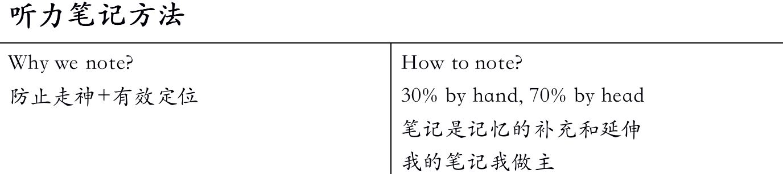

Slide 26
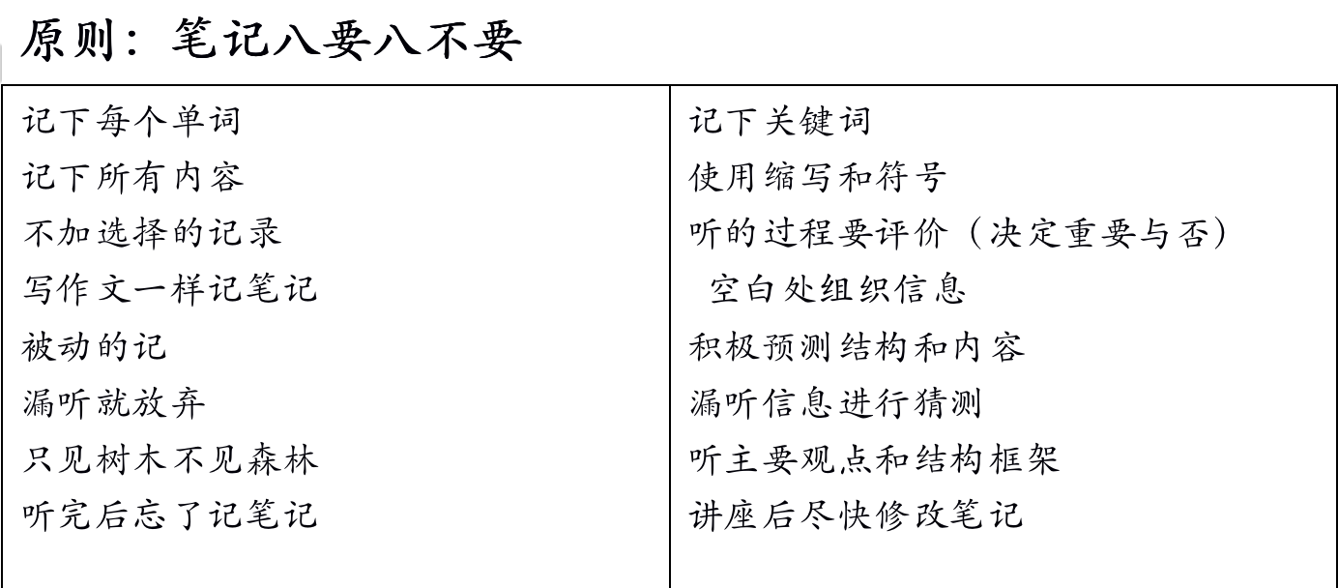

Slide 27
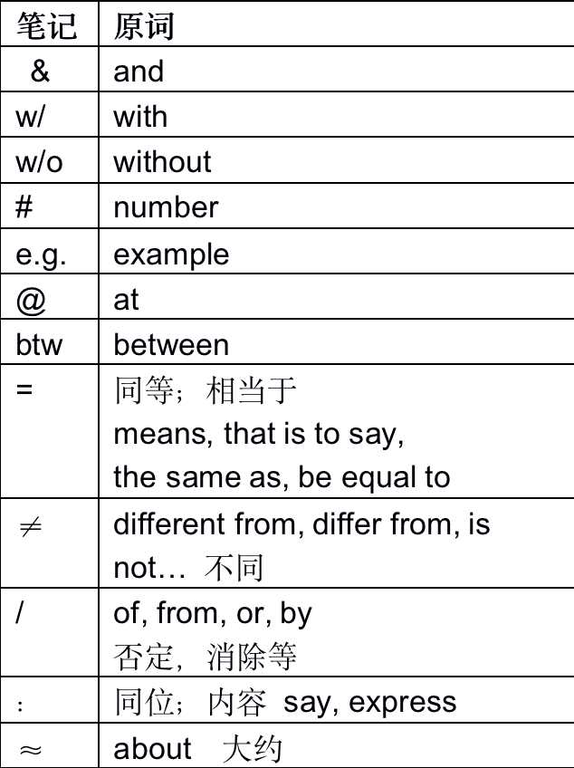
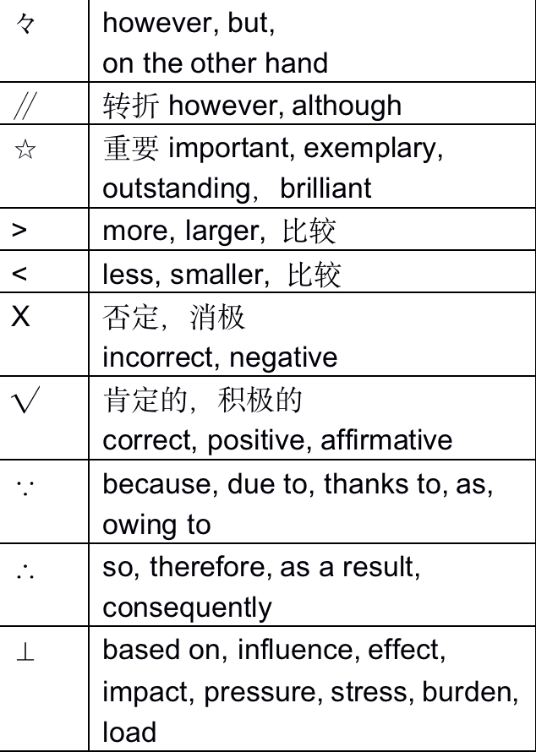

Slide 28
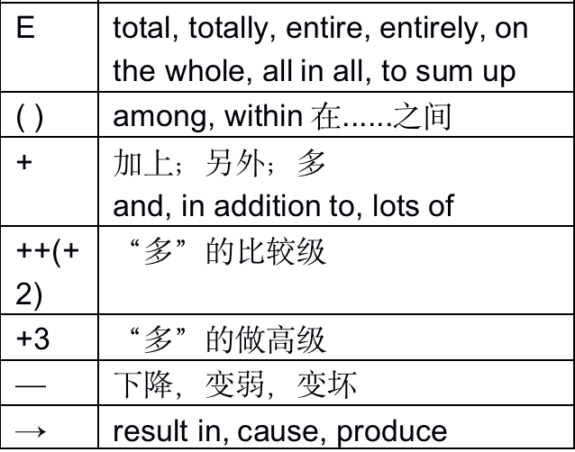
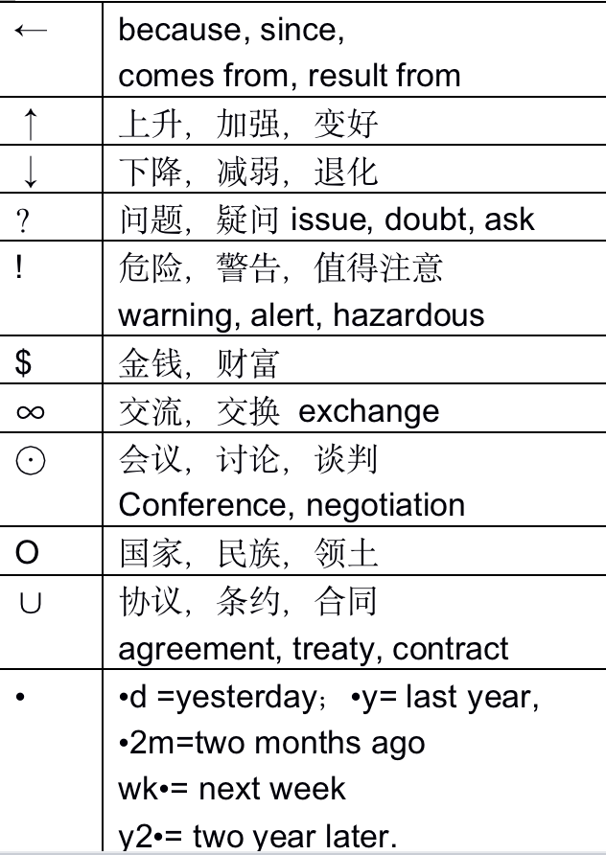

Slide 29
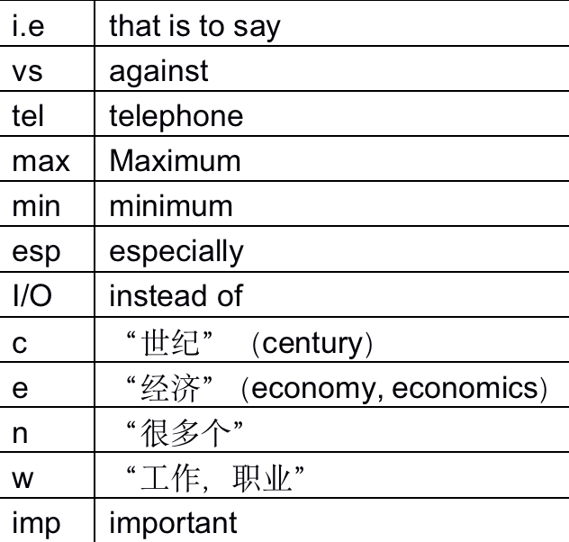

Slide 30
一、英文缩写
（一）保留开头字母
见上表
（二）拿掉所有元音
BZ（或biz）：business
MKT： market
MGR： manager
MSG： message
STD： standard
RCV： receive
ACPT： accept
AD： advertisement
ADS： address
DEPT： department
STD： standard
TKS： thanks
（四）根据发音 R： are U： You UR： Your THO： though THRU： through
（三）保留开头和结尾的辅音字母 WK： week RM： room

Slide 31
（五）词根的处理
-ism： 简写为m，例如：socialism可写成Sm
-tion： 简写为n，例如：standardization (标准化) stdn
-ing： 简写为—g 例如：marketing (市场营销) MKT—g
-ed： 简写为-d 例如：accepted（acptd）
-able/ible/ble 简写为bl 例如：available（avbl）
-ment 简写为 mt 例如：amendment（amdmt）
-ize 简写为 z 例如：recognize （regz）
-ful 简写为 fl 例如：meaningful（mnfl）

Slide 32
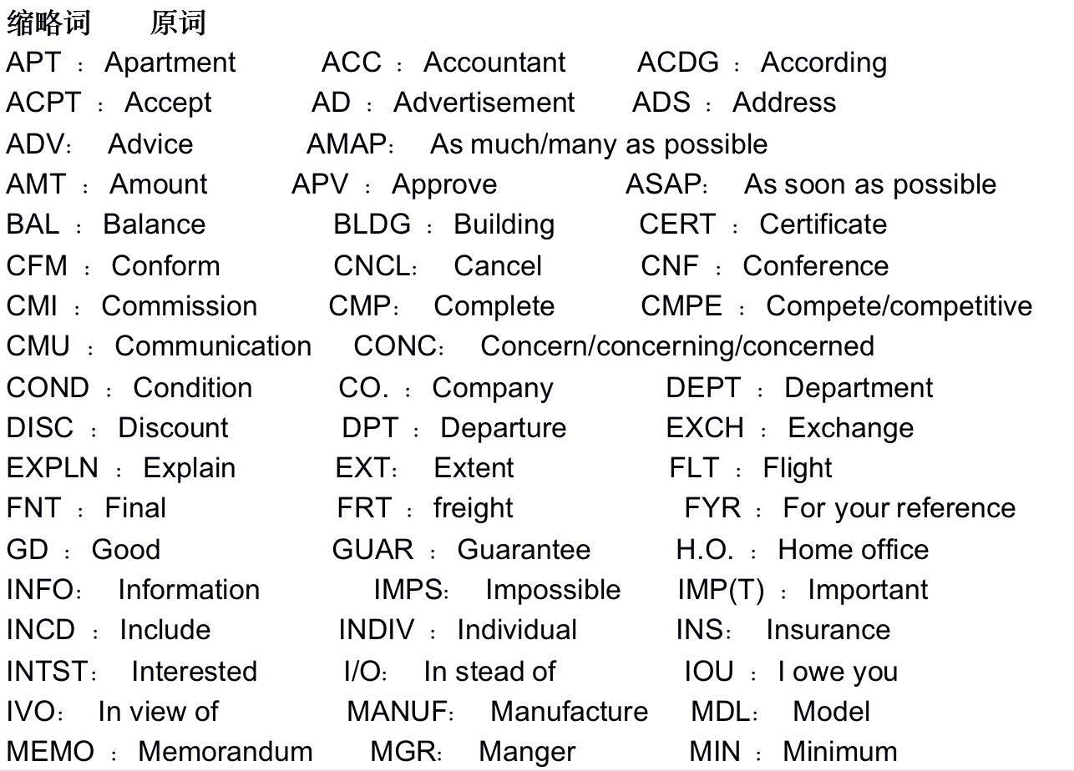

Slide 33
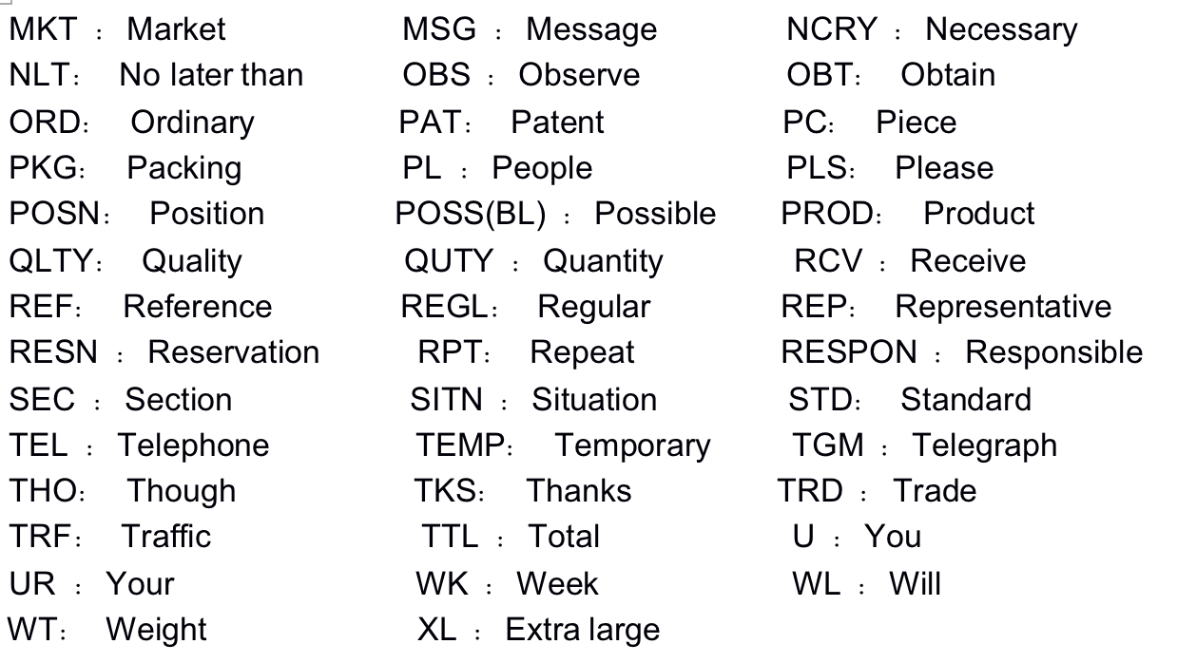

Slide 34
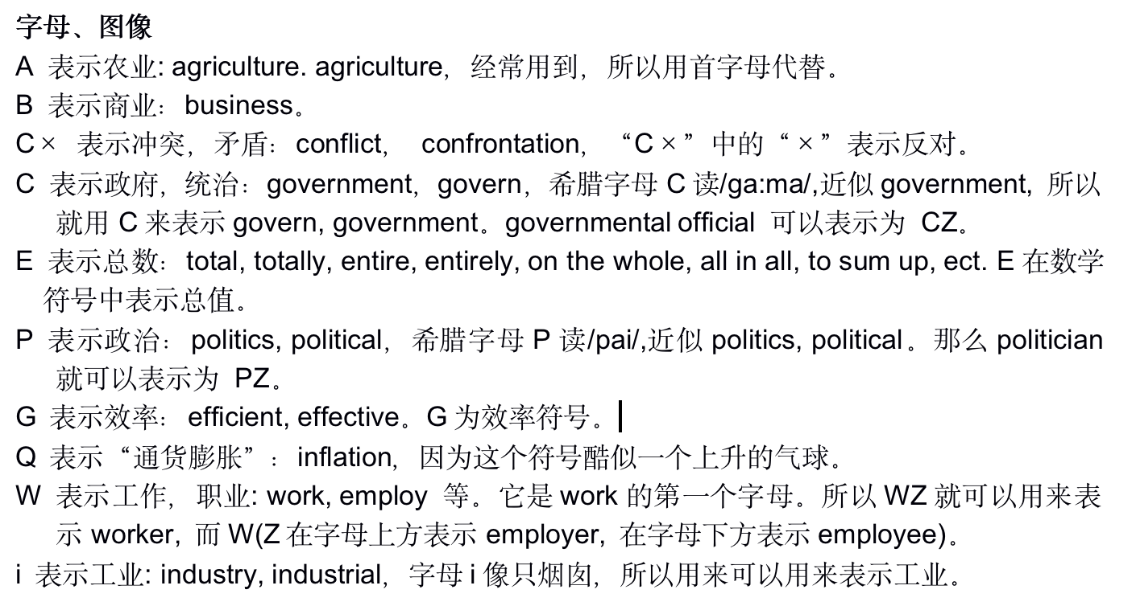

Slide 35
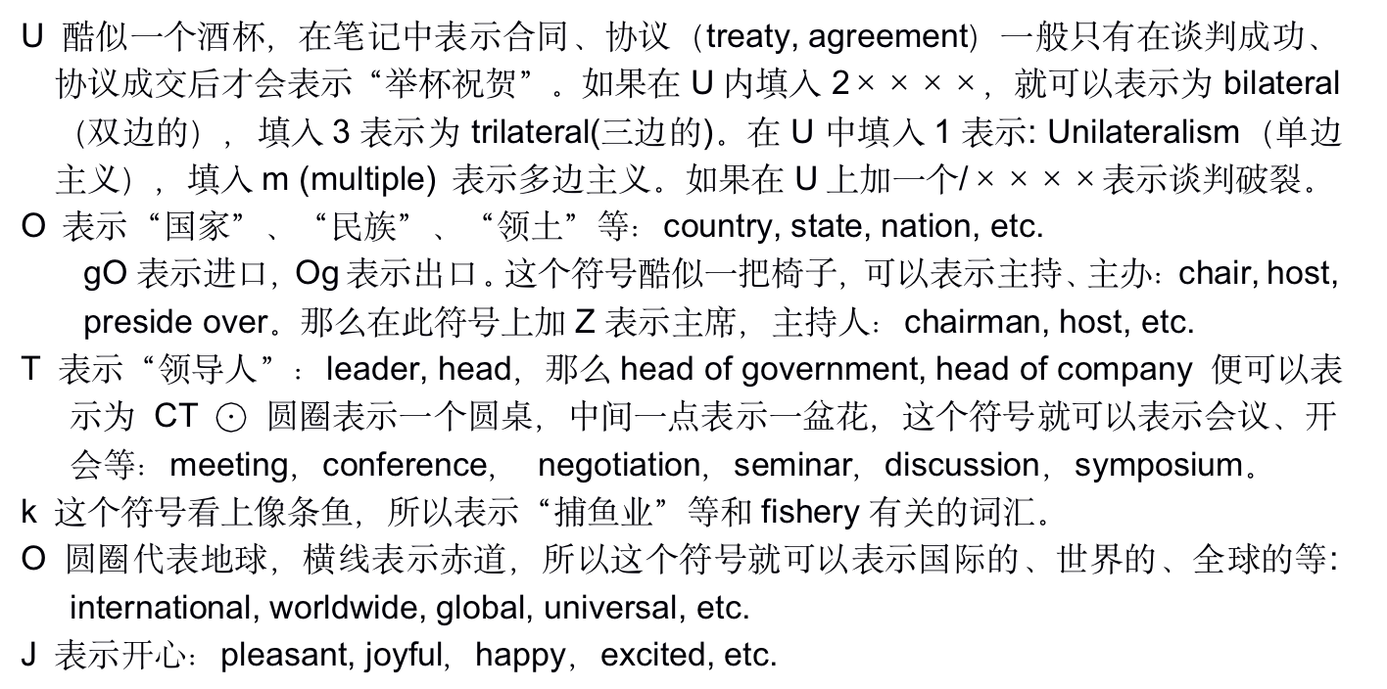
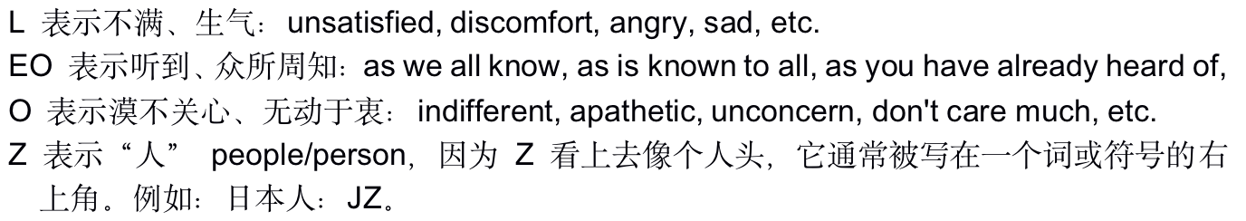

Slide 36
课后作业：
1. 回顾本次课内容，完成记忆内容
2. 完成TPO45-50的所有conversation题目
3. 预习对话场景词汇（见讲义）
题目群里打卡

Slide 37
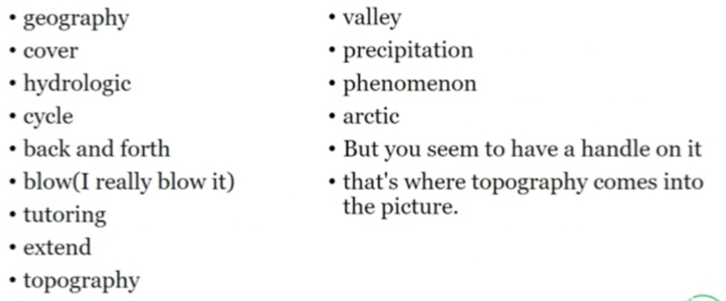
综合练习：
TPO24-C2

Slide 38
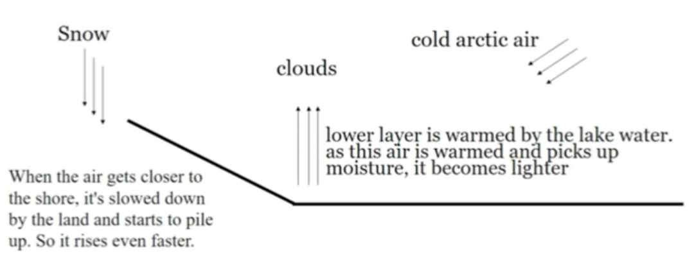
综合练习：
TPO24-C2

Slide 39
综合练习：
TPO24-C2
1.Why does the student go to speak with the professor?
A. To discuss material that might be on the final exam.
B. To review his answers to the midterm exam.
C. To get information about a class he missed.
D. To find out about the services of the tutoring center.

Slide 40
综合练习：
TPO24-C2
2.What does the professor tell the student about the tutoring center?
A. It will have extended hours during the final-exam period.
B. It is located in a building near where he works.
C. He can improve his writing skills there.
D. He can get help with geography there.

Slide 41
综合练习：
TPO24-C2
3.What aspect of the horologic cycle is the student confused about?
A. How the process of evaporation works.
B. How topographical features affect precipitation.
C. How water vapor in the atmosphere becomes rain.
D. How lake water fits into the cycle.

Slide 42
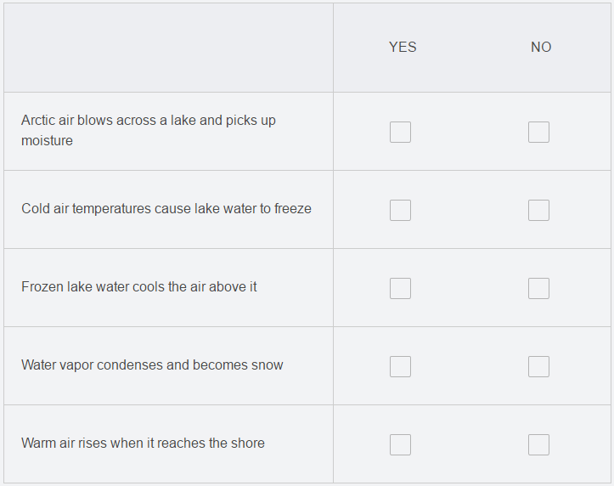
综合练习：
TPO24-C2
4.In the conversation, the professor describes the process that causes lake-effect snowstorms. Indicate whether each of the following is a step in the process

Slide 43
综合练习：
TPO24-C2
5.Why does the professor say this?
A. To make sure the student knows he will have to be familiar with topographical features for the final exam.
B. To remind the student of a diagram that she presented in class.
C. To point out the severity of weather conditions near the lake shore.
D. To reinforce the connection between her example and the student s question.

Slide 44
End

